Slide 1

Python Programming
(Business & Analytics)
by Su Lee Seng,
Jan, 2021

Slide 2
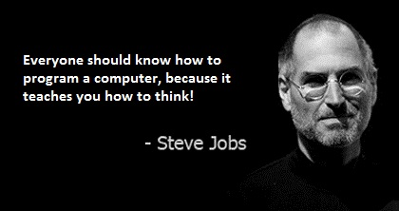
Python Programming
(Business & Analytics)
by Su Lee Seng,
Jan, 2021

Slide 3
Talk is cheap.
show me the code.

Slide 4

SAP HANA – An Introduction
@ UTAR
by Su Lee Seng,
April, 2014.

Slide 5
Python Programming
Python Strings

Slide 6
Python Programming – Python Strings :
What are Strings ?
In Python a string is a series, or sequence, of characters in order. In this definition a character is anything you can type on the keyboard in one keystroke, such as a letter 'a', 'b', 'c' or a number '1', '2', '3' or a special characters such as '\', '[', '$' etc. a space is also a character ' ', although it does not have a visible representation.
It should also be noted that strings are immutable. Immutable means that once a string has been created it cannot be changed. If you try to change a string you will in fact create a new string, containing whatever modifications you made, you will not affect the original string in anyway.
For the most part you can ignore this fact but it means that if you try to get a sub string or split a string you must remember to store the result

Slide 7
Python Programming – Python Strings :
What are Strings ?
To define the start and end of a string we have used the single quote character ', thus all of the following are valid strings:
'Hello'
'Hello World'
'Hello Andrea2000'
'To be or not to be that is the question!'
We can also define an empty string which has no characters in it (it is defined as a single quote followed immediately by a second single quote with no gap between them). This is often used to initialise or reset a variable holding a reference to a string, for example
some_string = ''

Slide 8
Python Programming – Python Strings :
Representing Strings
We have used single quotes to define the start and end of a string, however in Python single or double quotes can be used to define a string, thus both of the following are valid:
'Hello World'
"Hello World“
In Python these forms are exactly the same, although by convention we default to using single quotes.
'Hello World'' # This is illegal
''Hello World' # So is this

Slide 9
Python Programming – Python Strings :
Representing Strings
A single quote can be embedded in a string defined using double quotes and vice versa, thus we can write the following:
print("It's the day")
print('She said "hello" to everyone')
Output :
It's the day
She said "hello" to everyone

Slide 10
Python Programming – Python Strings :
Representing Strings
A third alternative is the use of triple quotes, which might at first hand seem a bit unwieldy, but they allow a string to support multi-line strings, for example:
34 4 Python Strings
z = """
Hello
World
"""
print(z)
Output :
Hello
World

Slide 11
Python Programming – Python Strings :
Strings
>>> character = ’a’
>>> word = " Hello "
>>> line = "ain ’t"
>>> print line
ain ’t
>>> back1 = ’C:\\Main’
>>> print back1
C:\Main
Unicode string
>>> print u" Hello, world ! “
Hello, world !
(..when dealing with text that contains non-ASCII characters )
raw string
>>> print r’C:\\Main’
C:\\Main
Notes:
If you find yourself dealing with text that contains non-ASCII characters, you have to learn about Unicode—what it is, how it works, and how Python uses it.

Slide 12
Python Programming – Python Strings :
Raw String
Output :
Hi
Hello
s = 'Hi\nHello'
print(s)
raw_s = r'Hi\nHello'
print(raw_s)
>>> s = 'Hi\xHello‘
File "<input>", line 1 SyntaxError: (unicode error) 'unicodeescape' codec can't decode bytes in position 2-3: truncated \xXX escape
Output :
Hi\nHello

Slide 13
Python Programming – Python Strings :
What Type Is String
The type of an item of data (such as a string) determines what it is legal to do with the data and what the effect of various actions will be. For example, what the effect of using a '+' operator is will depend on the types involved; if they are numbers then the plus operator will add them together; if however strings are involved then the strings will be concatenated (combined) together etc.
It is possible to find out what type a variable currently holds using the built-in type() function. This function takes a variable name and will return the type of the data held by that variable, for example:
my_variable = 'Bob'
print(type(my_variable))
Output :
<class 'str'>
Notes:
This is a shorthand for saying that what is held in my_variable is currently a class (type) of string (actually string is a class and Python supports ideas from Object Oriented Programming such as classes and we will encounter them later in the book).

Slide 14
Python Programming – Python Strings :
Strings
In the case of string handling, the operator + is used to concatenate two strings as the operation "hello"+" python" returns "hello python".
The operator * is known as a repetition operator as the operation "Python" *2 returns 'Python Python'.
The following example illustrates the string in Python
str = "string using double quotes"
print ( str )
s = '''A multiline
string'''
print (s)
Output :
string using double quotes A multiline string

Slide 15
Python Programming – Python Strings :
Strings -slicing
>>> "Hello " + "world"
'Hello world'
>>> "<+>"*4
'<+><+><+><+>'
>>> "<+>"*-2
''
Multiplying by any negative number creates a zero-length string.

Slide 16
Python Programming – Python Strings :
Strings - slicing
str1 = 'hello robert' #string str1
str2 = ' how are you' #string str2
print (str1[ 0 : 2 ]) #printing first two character using slice operator
print (str1[ 4 ]) #printing 4th character of the string
print (str1 *2 ) #printing the string twice
print (str1 + str2) #printing the concatenation of st r1 and str2
>>> str2="'Harsh Bhasin\
Author\
Delhi'"
>>> str2
"'Harsh BhasinAuthorDelhi'"
Output :
He
O
hello roberthello robert
hello robert how are you

Slide 17
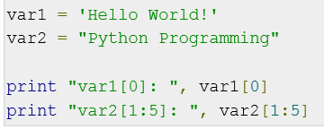

Python Programming – Python Strings :
Strings
xx
Output :
xx

Slide 18


Python Programming – Python Strings :
Strings
Output :
xx
>>> print("value", 355/113)
value 3.1415929203539825
>>> print("value", 355/113, sep='=')
value=3.1415929203539825
>>> print("value", 355/113, sep='=', end='!\n')
value=3.1415929203539825!

Slide 19
Python Programming – Python Strings :
Strings Slicing
Slicing, in strings, refers to removing some part of a string. For example:
>>>name = 'Sonam'
>>>name
'Sonam'
Here, if we intend to extract the portion after the first letter we can write [1:].
>>> name1=name[1:]
>>> name1
'onam‘

Slide 20
Python Programming – Python Strings :
Strings Slicing
In the same way the portion of the string after the first two letters can be extracted as follows.
>>>name = name[2:]
>>>name
'nam‘
Now, we modify the string by adding “man man”
>>>name = “man”+name
>>>name
'mannam'

Slide 21
Python Programming – Python Strings :
Strings Slicing
It may be noted that the last two characters cannot be removed in the same way as the first two. Observe the following output in order to understand the concept.
>>>name = name[:2]
>>>name
'ma‘

Slide 22
Python Programming – Python Strings :
Strings Slicing
>>> "multifaceted"[5:10]
'facet'
>>> "multifaceted"[:5]
'multi'
>>> "multifaceted"[5:]
'faceted'
"abcdefg"[1::2] will pick the odd positions: 1, 3, and 5.
The step size can also be negative. This will enumerate the index values in reverse order. The value of "word"[::-1] is 'drow'.

Slide 23
Python Programming – Python Strings :
Immutability of Strings
name = 'Hello' + name
we don’t actually change the string; as a matter of fact we create a new string having the value 'Hello' concatenated with the value stored in name. The concept can be understood by the fact that when we try to change the value of a particular character in a string, an error crops up.
>>>name='Anupam'
>>>name
'Anupam'
>>>name[2]='p‘
Output :
Traceback (most recent call last):
File “<pyshell#17>”, line 1, in <module>
name[2]='p'
TypeError: 'str' object does not support item assignment

Slide 24
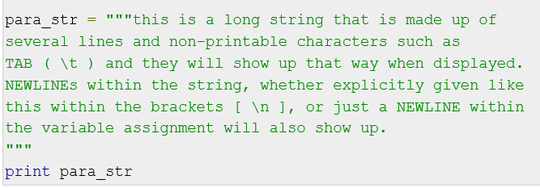
Python Programming – Python Strings :
Triple Quoting Mechanism
Python also includes the triple quoting mechanism for defining strings. This is useful for creating strings containing paragraphs or multiple lines. Triple quoted strings are also commonly used in docstrings.

Slide 25
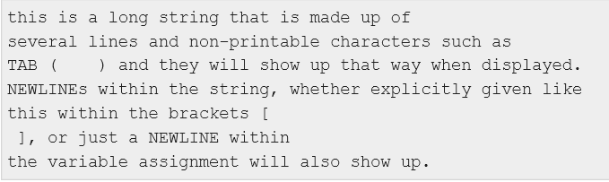
Python Programming – Python Strings :
Triple Quoting Mechanism
Note how every single special character has been converted to its printed form, right down to the last NEWLINE at the end of the string between the "up." and closing triple quotes. Also note that NEWLINEs occur either with an explicit carriage return at the end of a line or its escape code (\n) −
Output :

Slide 26
Python Strings
What can you do with strings ?
(built-in string methods)

Slide 27
Python Strings - What can you do with Strings ? :
String Concatenation ( + )
You can concatenate two strings together using the '+' operator (an operator is an operation or behaviour that can be applied to the types involved). That is you can take one string and add it to another string to create a new third string:
string_1 = 'Good'
string_2 = " day"
string_3 = string_1 + string_2
print(string_3)
print('Hello ' + 'World')
Output :
Good day
Hello World
Notes:
Notice that the way in which the string is defined does not matter here, string_1 used single quotes but string_2 used double quotes; however they are both just strings.

Slide 28
Python Strings - What can you do with Strings ? :
String Concatenation ( + )
name=input('Enter your name\t:')
result1 = 'Hi'+' there'
print(result1)
str1='Hello'
str2=str1 +' '+name
print(str2)
Note that the same operator is used for adding two integers. input() function returns every input by the user as string.
Output :
Enter your name :Kelvin
Hi there
Hello Kelvin
Notes:
xx

Slide 29
Python Strings - What can you do with Strings ? :
Length of a String ( len() )
It can sometimes be useful to know how long a string is, for example if you are putting a string into a user interface you might need to know how much of the string will be displayed within a field. To find out the length of a string in Python you use the len() function, for example:
print(len(string_3))
This will print out the length of the string currently being held by the variable string_3 (in terms of the number of characters contained in the string).

Slide 30
Python Strings - What can you do with Strings ? :
Accessing a Character
As a string is a fixed sequence of letters, it is possible to use square brackets and an index (or position) to retrieve a specific character from within a string. For example:
my_string = 'Hello World'
print(my_string[4])
However, you should note that strings are indexed from Zero! This means that the first character is in position 0, the second in position 1 etc. Thus stating [4] indicates that we want to obtain the fifth character in the string, which in this case is the letter 'o'. This form of indexing elements is actually quite common in programming languages and is referred to a zero based indexing.

Slide 31
Python Strings - What can you do with Strings ? :
Accessing a Subset of Characters
It is also possible to obtain a subset of the original string, often referred to as a substring (of the original string). This can again be done using the square brackets notation but using a ':' to indicate the start and end points of the sub string. If one of the positions is omitted then the start or end of the string is assumed (depending upon the omission), for example:
my_string = 'Hello World'
print(my_string[4]) # characters at position 4
print(my_string[1:5]) # from position 1 to 5
print(my_string[:5]) # from start to position 5
print(my_string[2:]) # from position 2 to the end
Output :
o
ello
Hello
llo World
Notes:
As such my_string[1:5] returns the substring containing the 2nd to 6th letters (that is 'ello').
In turn my_string[:5] returned the substring containing the 1st to 6th letters and
my_string[2:] the sub string containing the 3rd to the last letters.

Slide 32
Python Strings - What can you do with Strings ? :
Repeating Strings (Replication operator)
We can also use the '*' operator with strings. In the case of strings this means repeat the given string a certain number of times. This generates a new string containing the original string repeated n number of times. For example:
print('*' * 10)
print('Hi' * 10)
str1=input('Enter a string\t:')
num=int(input('Enter a number\t:'))
result1=num*str1
print(result1)
Output :
**********
HiHiHiHiHiHiHiHiHiHi
Output :
**********
Enter a string :abc
Enter a number 4
abcabcabcabc

Slide 33
Python Strings - What can you do with Strings ? :
Splitting strings
A very common requirement is the need to split a string up into multiple separate strings based on a specific character such as a space or a comma. This can be done with the split() function, that takes a string to used in identifying how to split up the receiving string. For example:
title = 'The Good, The Bad, and the Ugly'
print('Source string:', title)
print('Split using a space')
print(title.split(' '))
print('Split using a comma')
print(title.split(','))

Slide 34
Python Strings - What can you do with Strings ? :
Splitting strings
A very common requirement is the need to split a string up into multiple separate strings based on a specific character such as a space or a comma. This can be done with the split() function, that takes a string to used in identifying how to split up the receiving string. For example:
title = 'The Good, The Bad, and the Ugly'
print('Source string:', title)
print('Split using a space')
print(title.split(' '))
print('Split using a comma')
print(title.split(','))
Output :
Source string: The Good, The Bad, and the Ugly
Split using a space
['The', 'Good,', 'The', 'Bad,', 'and', 'the', 'Ugly']
Split using a comma
['The Good', ' The Bad', ' and the Ugly']
Notes:
As can be seen from this the result generated is either a list of each word in the string or three strings as defined by the comma.

Slide 35
Python Strings - What can you do with Strings ? :
Splitting strings
You may have noticed something odd about the way in which we wrote the call to the split operation. We did not pass the string into split() rather we used the format of the variable containing the string followed by '.' and then split().
This is because split() is actually what is referred to as a method. We will return to this concept more when we explore classes and objects. For the moment merely remember that methods are applied to things like string using the dot notation.
For example, given the following code
title = 'The Good, The Bad, and the Ugly'
print(title.split(' '))
This means take the string held by the variable title and split it based on the character space.

Slide 36
Python Strings - What can you do with Strings ? :
Splitting strings
>>> text="numerator=355,denominator=115"
>>> text.split(",")
['numerator=355', 'denominator=115']
>>> items= _
>>> items[0].partition("=")
('numerator', '=', '355')
>>> items[1].partition("=")
('denominator', '=', '115')
We used the partition("=") method on each item in the items variable to break the assignment down into name, =, and value

Slide 37
Python Strings - What can you do with Strings ? :
Counting strings
It is possible to find out how many times a string is repeated in another string. This is done using the count() operation for example
my_string = 'Count, the number of spaces'
print("my_string.count(' '):", my_string.count(' '))
…indicating that there are 4 spaces in the original string.
Output :
my_string.count(' '): 4

Slide 38
Python Strings - What can you do with Strings ? :
Counting strings
>>> str3=‘HARSH bhasin'
>>> str3.count('ha',0,len(str3))
1
>>> str2.count('ka',0,len(str3))
0

Slide 39
Python Strings - What can you do with Strings ? :
Replacing strings
One string can replace a substring in another string. This is done using the
replace() method on a string. For example:
welcome_message = 'Hello World!'
print(welcome_message.replace("Hello", "Goodbye"))
Output :
Goodbye World!

Slide 40
Python Strings - What can you do with Strings ? :
Finding sub-strings
You can find out if one string is a substring of another string using the find() method. This method takes a second string as a parameter and checks to see if that string is in the string receiving the find() method, for example:
string.find(string_to_find)
The method returns −1 if the string is not present. Otherwise it returns an index indicating the start of the substring. For example
print('Edward Alun Rawlings'.find('Alun'))
This prints out the value 7 (the index of the first letter of the substring 'Alun' note strings are indexed from Zero; thus the first letter is at position Zero, the second at position one etc.

Slide 41
Python Strings - What can you do with Strings ? :
Finding sub-strings
In contrast the following call to the find() method prints out −1 as 'Alun' is no longer part of the target string:
print('Edward John Rawlings'.find('Alun'))
>>> 'Hari' in ['Har', 'Hari', 'Hai']
True
>>>
>>> 'Hari' in ['Har', 'hari', 'Hai']
False

Slide 42
Python Strings - What can you do with Strings ? :
Converting Other Types into Strings
If you try to use the '+' concatenation operator with a string and some other type such as a number then you will get an error. For example if you try the following:
msg = 'Hello Lloyd you are ' + 21
print(msg)
You will get an error message indicating that you can only concatenate strings with strings not integers with strings. To concatenate a number such as 21 with a string you must convert it to a string. This can be done using the str() function.

Slide 43
Python Strings - What can you do with Strings ? :
Converting Other Types into Strings
This contest any type into a string representation of that type. For example:
msg = 'Hello Lloyd you are ' + str(21)
print(msg)
Output :
Hello Lloyd you are 21

Slide 44
Python Strings - What can you do with Strings ? :
Comparing strings
To compare one string with another you can use the '==' equality and '!=' not equals operators. These will compare two strings and return either True or False indicating whether the strings are equal or not. For example:
print('James' == 'James') # prints True
print('James' == 'John') # prints False
print('James' != 'John') # prints True
You should note that strings in Python are case sensitive thus the string 'James‘ does not equal the string 'james'. Thus:
print('James' == 'james') # prints False

Slide 45
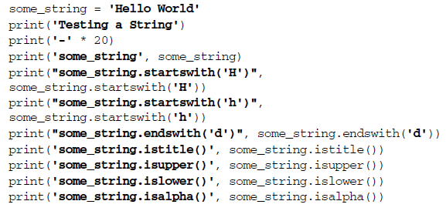
Python Strings - What can you do with Strings ? :
Other String Operations
xxxx

Slide 46
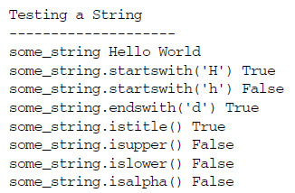
Python Strings - What can you do with Strings ? :
Other String Operations
xxxx

Slide 47
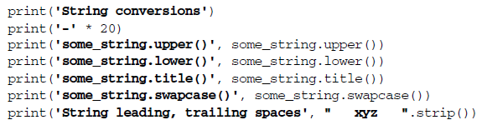
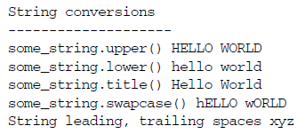
Python Strings - What can you do with Strings ? :
Other String Operations
xxxx
Output :

Slide 48
Python Strings - What can you do with Strings ? :
Other String Operations
>>> str3=‘HARSH bhasin'
>>> str3.isalnum()
False
>>> str3.isalpha()
False
>>> str3.isdecimal()
False
>>> str3.isdigit()
False
>>> str3.isidentifier()
False
>>> str3.islower()
False
>>> str3.isnumeric()
False
>>> str3.replace('h','p')
'HARSH bpasin'

Slide 49
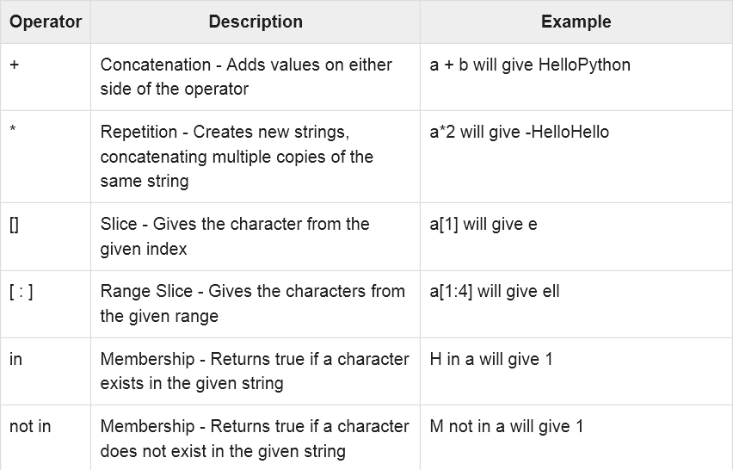
Python Strings - What can you do with Strings ? :
String Special Operator
xxxx

Slide 50
Python Strings strings formatting

Slide 51
Python Strings - strings formatting :
Python Strings Are Case Sensitive
In Python the string 'l' is not the same as the string 'L'; one contains the lower-case letter 'l' and one the upper-case letter 'L'. If case sensitively does not matter to you then you should convert any strings you want to compare into a common case before doing any testing; for example using lower() as in
some_string.lower().startswith('h')
Be very careful with capitalisation of function/method names; in Python isupper() is a completely different operation to isUpper(). If you use the wrong case Python will not be able to find the required function or method and will generate an error message.
Notes:
Do not worry about the terminology regarding functions and methods at this point—for now they can be treated as the same thing and only differ in the way that they recalled or invoked.

Slide 52
Python Strings - strings formatting :
Function/Method Invocations
Also be careful of always including the round brackets when you call a function or method; even if it takes no parameters/arguments. There is a significant difference between isupper and isupper(). The first one is the name of an operation on a string while the second is a call to that operation so that the operation executes.
Both formats are legal Python but the result is very different, for example:
print(some_string.isupper)
print(some_string.isupper())
Output :
<built-in method isupper of str object at 0x105eb19b0>
False
Notes:
Notice that the first print out tells you that you are referring to the built-in method called isupper defined on the type String; while the second actually runs isupper() for you and returns either True or False.

Slide 53
Python Strings - strings formatting :
String Formatting
The string formatting system uses a special string known as the format string that acts as a pattern defining how the final string will be laid out. This format string can contain placeholders that will be replaced with actual values when the final string is created. A set of values can be applied to the format string to fill the placeholders using the format() method.
The simplest example of a format string is one that provides a single placeholder indicated by two curly braces (e.g. {}).

Slide 54
Python Strings - strings formatting :
String.format
For example, the following is a format string with the pattern 'Hello' followed by a placeholder:
format_string = 'Hello {}!'
This can be used with the format() string method to provide a value (or populate) the placeholder, for example:
print(format_string.format('Phoebe'))
The output from this is:
Hello Phoebe!

Slide 55
Python Strings - strings formatting :
String.format
A format string can have any number of placeholders that must be populated, for example the next example has two placeholders that are populated by providing two values to the format() method:
# Allows multiple values to populate the string
name = "Adam"
age = 20
print("{} is {} years old".format(name, age))
In this case the output is:
Adam is 20 years old

Slide 56
Python Strings - strings formatting :
String.format
By default the values are bound to the placeholders based on the order that they are provided to the format() method; however this can be overridden by providing an index to the placeholder to tell it which value should be bound, for example:
# Can specify an index for the substitution
format_string = "Hello {1} {0}, you got {2}%"
print(format_string.format('Smith', 'Carol', 75))
In this case the second string 'Carol' will be bound the first placeholder; note that the parameters are numbered from Zero not one.
The output from the above example is:
Hello Carol Smith, you got 75%

Slide 57
Python Strings - strings formatting :
String.format
An alternative approach is to use named values for the placeholders. In this approach the curly brackets surround the name of the value to be substituted, for example {artist}.
# Can use named substitutions, order is not significant
format_string = "{artist} sang {song} in {year}"
print(format_string.format(artist='Paloma Faith',
song='Guilty', year=2017))
In this example the order no longer matters as the name associated with the parameter passed into the format() method is used to obtain the value to be substituted. In this case the output is:
Paloma Faith sang Guilty in 2017

Slide 58
Python Strings - strings formatting :
String.format
It is also possible to indicate alignment and width within the format string. For example, if you wish to indicate a width to be left for a placeholder whatever the actual value supplied, you can do this using a colon (':') followed by the width to use. For example to specify a gap of 25 characters which can be filled with a substitute value you can use {:25} as shown below:
print('|{:25}|'.format('25 characters width'))
In the above the vertical bars are merely being used to indicate where the string starts and ends for reference, they have no meaning within the format method. This produces the output:
|25 characters width |

Slide 59
Python Strings - strings formatting :
String.format
Within this gap you can also indicate an alignment where:
• < Indicates left alignment (the default),
• > Indicates right alignment,
• ^ Indicates centered.
These follow the colon (':') and come before the size of the gap to use, for example:
print('|{:<25}|'.format('left aligned')) # The default
print('|{:>25}|'.format('right aligned'))
print('|{:^25}|'.format('centered'))
Output :
|left aligned |
| right aligned|
| centered |

Slide 60
Python Strings - strings formatting :
String.format
Another formatting option is to indicate that a number should be formatted with separators (such as a comma) to indicate thousands:
# Can format numbers with comma as thousands separator
print('{:,}'.format(1234567890))
print('{:,}'.format(1234567890.0))
Output :
1,234,567,890
1,234,567,890.0

Slide 61
Python Programming – strings formatting :
String.format
>>> name = ’Matt ’
>>> print ’Hello {0} ’. format ( name )
Hello Matt
When a string contains curly braces ({ and }) with an integer inside it, the braces serve as a placeholder for the variable passed into format. In this case you are telling Python to replace {0} with the contents of name or the string Matt.
Another useful property of formatting is that you can also format non-string objects, such as numbers:
>>> print ’I :{0} R :{1} S :{2} ’. format (1, 2.5 , ’foo ’)
I:1 R :2.5 S:foo
Notes:
If you are paying careful attention, you will note that the numbers in the curly braces are incrementing. In reality they tell the format operation which object to insert and where. Many computer languages start counting from 0, so {0} would correspond with the integer 1, and the {1} would be 2.5, while the {2} is the string ’foo’.

Slide 62
Python Programming – strings formatting :
String.format
If an object is passed into the format string attributes can be looked up used .attribute_name syntax. There is also support for pulling index-able items out by using [index] as well:
>>> ’Name : {0} ’. format (’Paul ’)
’Name : Paul ’
>>> ’Name : { name }’. format ( name =’John ’)
’Name : John ’
>>> ’Name : {[ name ]} ’. format ({’ name ’:’ George ’})
’Name : George ’

Slide 63
Python Programming – strings formatting :
String.format
>>> print ’matt ’. capitalize ()
Matt
>>> print ’Hi {0} ’. format (’there ’)
Hi there
>>> print ’YIKES ’. lower ()
yikes
capitalize (which is a method that capitalizes a string), format (which as you illustrated, allows for formatting of strings), or lower (which is a method used to ensure the string is lowercase). These attributes happen to be methods, which are easy to invoke on a string:
The function capitalizes the first character of the string. Note that only the first character will be capitalized.

Slide 64
Python Programming – strings formatting :
String.capitalize
Here is an example of calling the capitalize method on a string:
>>> name = ’matt ’
# invoked on variable
>>> correct = name . capitalize ()
>>> print correct
Matt
# invoked on data
>>> print ’fred ’. capitalize ()
Fred

Slide 65
Python Programming – strings formatting :
String.capitalize
In Python methods and functions are first-class objects. If the parentheses are left off, Python will not throw an error, it will simply show a reference to a method:
>>> print ’fred ’. capitalize
<built -in method capitalize of str object at
0 x7ff648617508 >

Slide 66
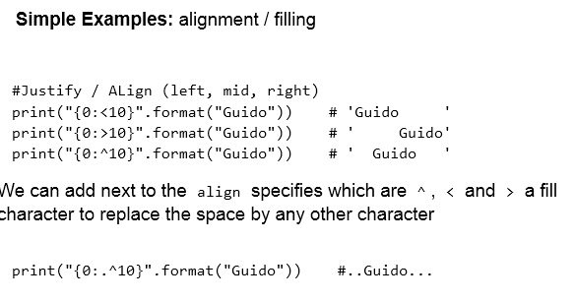
Python Programming – strings formatting :
String.format
xxx

Slide 67
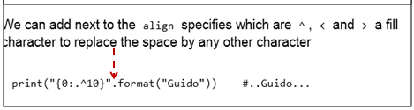
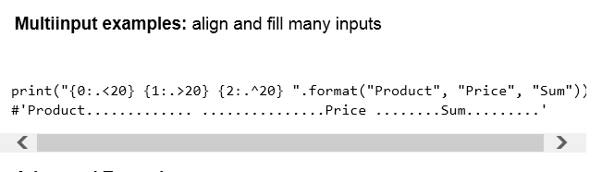
Python Programming – strings formatting :
String.format
xxx

Slide 68
Python Programming – strings formatting :
endswith
>>> xl = ’Oct2000 .xls ’
>>> xl. endswith (’.xls ’)
True
>>> xl. endswith (’. xlsx ’)
False
>>> str3=‘HARSH bhasin'
>>> str3.endswith('n')
True

Slide 69
Python Programming – strings formatting :
find
The find method allows you to find substrings inside other strings. It returns the index (offset starting at 0) of the matched substring. If no substring is found it returns -1:
>>> word = ’grateful ’
# 0 is g, 1 is r, 2 is a
>>> word . find (’ate ’)
2
>>> word . find (’great ’)
-1
>>> str2='harsh bhasin'
>>> str2
'harsh bhasin'
>>> str2.find('ha')
0
>>> str2.find('ha',3,len(str2))
7
(sub-string, initial index, the final index)

Slide 70
Python Programming – strings formatting :
format
format allows for easy creation of new strings by combining existing variables. The variables replace {X} (where X is an integer):
>>> print ’name : {0} , age: {1} ’.\
... format (’Matt ’, 10)
name : Matt , age: 10
>>> x = 12.3897 #Assign value to variable x
>>> print(x) # print x
12.3897
>>> format(x,” .2f”) #Return formatted string
‘12.39’
By placing a \ following a . you indicate to Python that you want to continue on the next line.

Slide 71
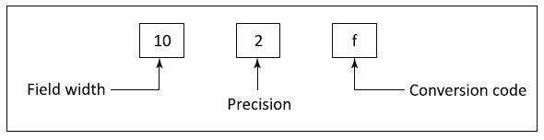
Python Programming – strings formatting :
format
print(format(10.345,”10.2f”))
print(format(10,”10.2f”))
print(format(10.32245,”10.2f”))
>>>print(format(10.234566,”10.2f”)) #Right Justification
10.23
>>> print(format(10.234566,”<10.2f”)) #Left Justification 10.23
Output :
10.35
10.00
10.32

Slide 72
Python Programming – strings formatting :
Format – Left/Right Justified
>>> print(format(1234,”10d”)) #Right Justification
1234
>>> print(format(“Hello World!”,”25s”) #Left Justification Hello World!
>>>print(format(“HELLO WORLD!”,”>20s”)) #String Right Justification
HELLO WORLD!
>>> print(format(0.31456,”10.2%”))
>>> print(format(3.1,”10.2%”))
>>> print(format(1.765,”10.2%”))
Output :
31.46%
310.00%
176.50%
Notes:
In the above example, the statement print(format(0.31456,”10.2%”)), contains the format specifier 10.2%. It causes the number to be multiplied by 100. The 10.2% denotes the integer to be formatted with a width of 10. In width, % is counted as one space.

Slide 73
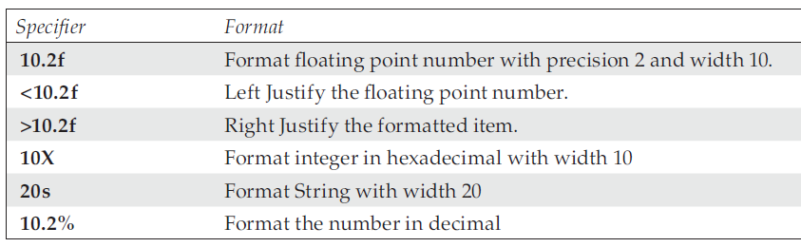
Python Programming – strings formatting :
format
>>> print(format(31.2345,”10.2e”))
3.12e+01
>>> print(format(131.2345,”10.2e”))
1.31e+02
Frequently used specifiers :

Slide 74
Python Programming – strings formatting :
format
>>> print ’I :{0} R :{1} S :{2} ’. format (1, 2.5 , ’foo ’)
I:1 R :2.5 S:foo
>>> ’Name : {0} ’. format (’Paul ’)
’Name : Paul ’
>>> ’Name : { name }’. format ( name =’John ’)
’Name : John ’
>>> ’Name : {[ name ]} ’. format ({’ name ’:’ George ’})
’Name : George ’

Slide 75
Python Programming – strings formatting :
format
>>> " Name : {0:*^12}". format (" Ringo ")
’Name : *** Ringo **** ’
Format a percentage using a width of 10, one decimal place and the sign before the width padding:
>>> " Percent : {0:=10.1%}". format ( -44./100)
’Percent : - 44.0% ’
Binary and hex conversions:
>>> " Binary : {0:b}". format (12)
’Binary : 1100 ’
>>> "Hex: {0:x}". format (12)
’Hex: c’

Slide 76
Python Programming – strings formatting :
format
>>> print " word ".\
... find (’ord ’)
1
>>> print " word ". find (
... ’ord ’)
1
Use ( followed by . Then, )

Slide 77
Python Programming – strings formatting :
String.join
join creates a new string from a sequence by inserting a string between every member of the list:
>>> ’, ’. join ([’1’,’2’, ’3’])
’1, 2, 3’
startswith is analogous to endswith except that it checks that a string starts with another string:
>>> ’Book ’. startswith (’B ’)
True
>>> ’Book ’. startswith (’b ’)
False
Notes:
For most Python interpreters, using join is faster than repeated concatenation using the + operator. The above idiom is common.

Slide 78
Python Programming – strings formatting :
strip
strip removes preceding and trailing whitespace (spaces, tabs, newlines) from a string. This may come in handy if you have to normalize data or parse input from a user (or the web):
>>> ’ hello there ’. strip ()
’hello there ’
Note that three spaces at the front of the string were removed as were the two at the end. But the two spaces between the words were left intact. If you are interested in removing only the leading whitespace or rightmost whitespace, the methods lstrip and rstrip respectively will perform those duties.

Slide 79
Python Strings strings templates

Slide 80
Python Strings - Hint on strings :
String Templates
A string template is a class (type of thing) that is created via the string. Template() function. The template contains one or more named variables preceded with a $ symbol. The Template can then be used with a set of values that replace the template variables with actual values.
For example:
import string
# Initialise the template with ¢variables that
# will be substitute with actual values
template = string.Template('$artist sang $song in $year')

Slide 81
Python Strings - Hint on strings :
String Templates
Note that it is necessary to include an import statement at the start of the program as Templates are not provided by default in Python; they must be loaded from a library of additional string features. This library is part of Python but you need to tell Python that you want to access these extra string facilities.
The Template itself is created via the string.Template() function. The string passed into the string.Template() function can contain any characters plus the template variables (which are indicated by the $ character followed by the name of the variable such as $artist above).

Slide 82
Python Strings - Hint on strings :
String Templates
The actual values can be substituted into the template using the substitute() function. The substitute function takes a set of key=value pairs, in which the key is the name of the template variable (minus the leading $ character) and the value is the value to use in the string.
print(template.substitute(artist='Freddie Mercury', song='The Great Pretender', year=1987))
In this example $artist will be replaced by 'Freddie Mercury', $song by 'The Great Pretender' and $year by 1987. The substitute function will then return a new string containing
'Freddie Mercury sang The Great Pretender in 1987'

Slide 83
Python Strings - Hint on strings :
String Templates
Output :
Freddie Mercury sang The Great Pretender in 1987
This is illustrated in the following code:
import string
# Initialise the template with $variables that
# will be substitute with actual values
template = string.Template('$artist sang $song in $year')
# Replace / substitute template variables with actual values
# Can use a key = value pairs where the key is the name of
# the template Variable and the value is the value to use
# in the string
print(template.substitute(artist='Freddie Mercury', song='The Great Pretender', year=1987))

Slide 84
Python Strings - Hint on strings :
String Templates
We can reuse the template by substituting other values for the template variables, each time we call the substitute() method it will generate a new string with the template variables replaced with the appropriate values:
print(template.substitute(artist='Ed Sheeran', song='Galway Girl', year=2017))
print(template.substitute(artist='Camila Cabello',
song='Havana', year=2018))
Output :
Ed Sheeran sang Galway Girl in 2017
Camila Cabello sang Havana in 2018

Slide 85
Python Strings - Hint on strings :
String Templates
Alternatively you can create what is known as a dictionary. A dictionary is a structure comprised of key:value pairs in which the key is unique. This allows a data structure to be created containing the values to use and then applied to the substitute function:
d = dict(artist = 'Billy Idol', song='Eyes Without a Face',
year = 1984)
print(template.substitute(d))
Output :
Billy Idol sang Eyes Without a Face in 1984

Slide 86
Python Programming – Python Strings :
Miscellaneous Functions
1. isanum()
2. isalpha()
3. isdecimal()
4. isdigit()
5. isidentifier()
6. islower()
7. isupper()
8. swapcase()
9. isspace()
10. lstrip()
11. rstrip()
12. replace()
13. join()
checks if the given string
contains only lower case characters
swaps the case of the given string, as in converts the upper case to lower and
lower to upper.
Extra spaces can be removed from the left and the right
hand sides by using the lstrip() and rstrip() functions.

Slide 87
Python Programming – Python Strings :
help
>>> help (’ some string ’. upper )
Help on built -in function upper :
upper (...)
S. upper () -> string
Return a copy of the string S
converted to uppercase .

Slide 88
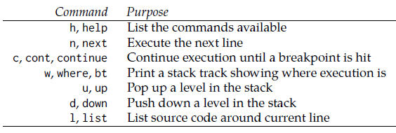
Python Programming – Python Strings :
pdb
Python includes a debugger to step through code named pdb. This library is modeled somewhat after the gdb library for C. To drop into the debugger at any point a Python program, insert the code import pdb; pdb.set_trace(). When this line is executed it will present a (pdb) prompt, which is similar to the REPL. Code can be evaluated and inspected live. Also breakpoints can be set and further inspection can take place.
Notes:
Many Python developers use print debugging. They insert print statements to provide clarity as to what is going on. This is often sufficient. Just make sure to remove the debug statements or change them to logging statements before releasing the code. When more exploration is required, the pdb module can be useful.

Slide 89
Python Programming – A First Python Program :
Escape Sequence
Python uses the backslash character, \, called an escape sequence in strings, to allow for the insertion of any type of quote inside of strings.
The character that follows the backslash in an escape sequence may be interpreted as mentioned in Python's official documentation, which follows. Of particular note is \n, which is used to create a new line:

Slide 90
Python Programming – A First Python Program :
Escape Sequence
This special notation consists of a backslash (\) followed by a letter or a combination of digits and is called an escape sequence. Using backslash, the special characters within print can be written as shown below.
>>> print(“The flight attendant asked,\”May I see your boarding pass?\” “)
Output :
The flight attendant asked, “May I see your boarding pass?”
In the above example, we have used backslash before the quotation marks to display the quotation marks in the output.

Slide 91
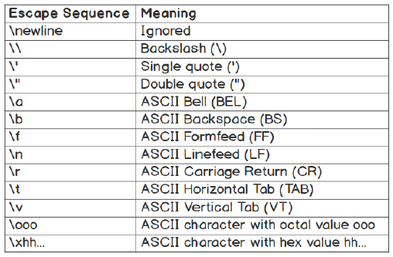
Python Programming – A First Python Program :
Escape Sequence and their Meaning
xxxx
Notes:
Note
For more information on strings, you can refer to https://docs.python.org/2.0/ref/strings.html.

Slide 92
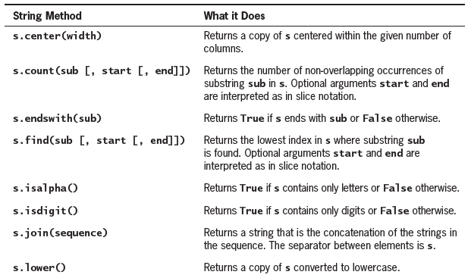
Python Programming – A First Python Program :
Conclusion : Useful String Methods
xxxx

Slide 93
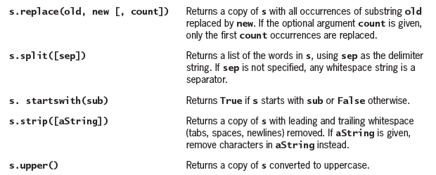
Python Programming – A First Python Program :
Conclusion : Useful String Methods
xxxx

Slide 94
Python Strings - Hint on strings :
Online Resources
There is a great deal of online documentation available on strings in Python including:
• https://docs.python.org/2.0/ref/strings.html More information on strings
• https://docs.python.org/3/library/string.html which presents common string operations.
• https://docs.python.org/3/library/stdtypes.html#text-sequence-type-str this provides information on strings and the str class in Python.
<< Exercise B04 >>

Slide 95
Python Strings - Hint on strings :
Online Resources
• https://pyformat.info has a simple introduction to Python string formatting.
• https://docs.python.org/3/library/string.html#format-string-syntax which presents detailed documentation on Python string formatting.
• https://docs.python.org/3/library/string.html#template-strings for documentation on string templates.

Slide 96
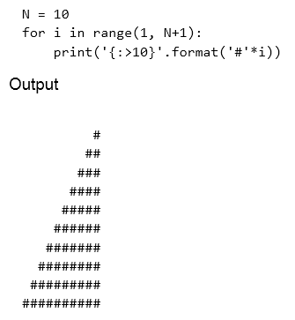

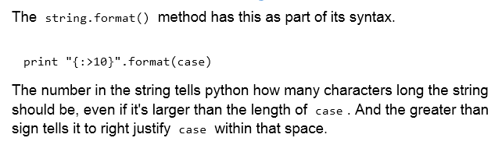
Python Strings - Hint on strings :
Extra- Right justified
xxx

Slide 97
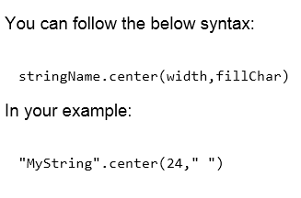
Python Strings - Hint on strings :
Extra- Center justified
xxx

Slide 98
Thank you

